Slide 1
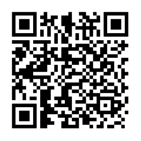
Lightwave in forensic science
23rd September 2020

Slide 2
Outline
Introduction
Review of basic principles of light wave in forensics science
Electromagnetic spectrum : ultraviolet, visible and infrared
Interaction of light and matter : reflection, luminescence and scattering
Forensic light sources : Alternative light source
Light wave applications

Slide 3
Introduction
In forensic examination of evidence, scientists make use of all types of light sources.
Different wavelengths of the optical spectrum offer a very useful tool to the non-destructive detection of latent evidence.
The optical spectrum used in forensic examinations
include ultraviolet, visible and infrared.

Slide 4
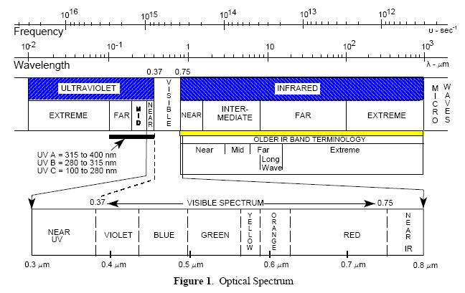
Electromagnetic Spectrum
Notes:
ใน slide จะอธิบายเกี่ยวกับ spectrum ของ คลื่นแม่เหล็กไฟฟ้า โดยเฉพาะในช่วง UV, visible และ infrared โดยเน้นว่าในการนิยามว่าแต่ละช่วงสามารถทำการกำหนดได้ด้วยความยาวคลื่นหรือความถี่ และส่วนที่นำมาใช้งานเป็นช่วงไหนบ้าง

Slide 5
UltraViolet Light
Short wavelength or far UV (UV C) :100 to 280 nm for sterilization,
Medium wavelength (UV B) : 280 to 315 nm for cosmetic purposes,
Long wavelength or near UV (UV A): 315 to 400 nm for forensic identifications of latent evidence.
Examples of latent evidence includes
- fingerprints,
- body fluids, i.e. blood, saliva, semen etc. on
clothes,
- bite marks and faded bruises,
- writing on documents.
Notes:
Latent evidence cannot be seen under normal
ambient lighting.
- Some types of enhancement may be needed to
clarify details.

Slide 6
UV Sources and UV detection
UV Sources :
Gas-discharged tubes : polychromatic light sources,
examples include black light tubes,
mercury and xenon lamps.
Solid-state sources : highly monochromatic light sources
examples includes UV light emitting
and UV lasers.
UV detection : a direct detection by a specially made detector or an indirect detection via optical phenomena, i.e., fluorescence and phosphorescence.
Notes:
Traditional light sources for UV work are all based on gas-discharge tubes. These tubes sometimes look like purple or pale-blue fluorescent light tubes. Tubes with mercury vapor generate UV light in the 365-nm band, and different gas pressures in the tubes can change the wavelength of UV light emission.
Gas-discharge tubes suffer from several disadvantages. The output is relatively weak compared to solid-state sources, and the illumination angle is quite wide, making it difficult to achieve high-intensity illumination. The output spectrum is quite wide, since there are many emission lines in a gas discharge. If monochromatic UV is required, then the output of the tube must be filtered. They are also fragile, require hazardous drive voltages, and have limited lifetimes, particularly in the case of xenon short-arc lamps.
In recent years, high-brightness UV LEDs have become commercially available and are starting to displace gas-discharge tubes in a variety of applications. These devices are based on gallium nitride semiconductors and can be found in wavelengths down to 365 nm, although today the most common UV LED wavelengths are 370 and 395 nm. The light from these sources is highly monochromatic due to the nature of semiconductor light sources that have an energy band gap.

Slide 7
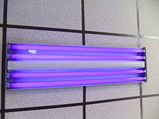
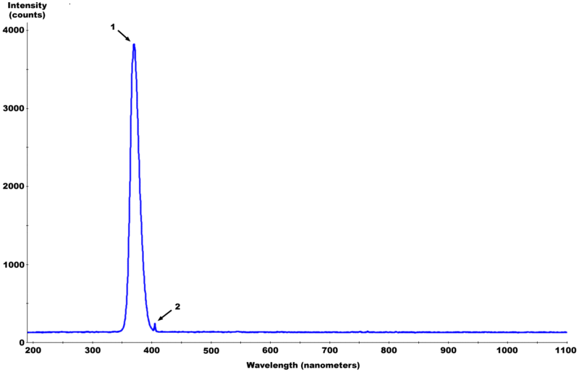
Black light
A tube black light is a basically a fluorescent lamp containing mercury vapor with a different sort of phosphor coating. This coating absorbs harmful shortwave UV-B and UV-C light and emits UV-A light (@370 nm).
The "black" glass tube itself blocks most visible light, so in the end only benign long-wave UV-A light, along with some blue and violet visible light, passes through.
UVA is capable of causing damage to collagen fibers, however, so it does have the potential to accelerate skin aging and cause wrinkles.
(1) Spectrum of a black light fluorescent tube. FWHM spectral bandwidth of the 370 nm peak is about 20 nm. The tiny secondary peak (2) is light from the mercury vapor line at 404 nm leaking through the filter, which gives the lamp its purple glow.
https://en.wikipedia.org/wiki/Blacklight#/media/File:Fluorescent_Black-Light_spectrum_with_peaks_labelled.gif
How can we detect the UV?
Notes:
The spectral emission depends on the properties of the plasma, such as temperature, pressure and atomic as well as molecular content.
Phosphor is coated inside the glass tube to allow only light with a wavelength of 370 nm to emit.

Slide 8
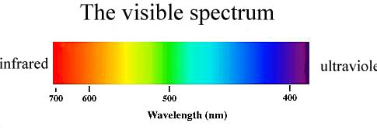
Visible Light
Visible light spectrum extends from 400 to 700 nm.
Visible light can be detected by human eyes.
The human perceptions respond to different wavelengths in terms of different color perception ranging from violet (short wavelength) to red (long wavelength).
https://web.pa.msu.edu/courses/2000fall/phy232/lectures/emwaves/visible.html
Notes:
In visual neuroscience, spectral sensitivity is used to describe the different characteristics of the photopigments in the rod cells and cone cells in the retina of the eye. It is known that the rod cells are more suited to scotopic vision and cone cells to photopic vision, and that they differ in their sensitivity to different wavelengths of light.^{[2][3]} It has been established that the maximum spectral sensitivity of the human eye under daylight conditions is at a wavelength of 555 nm, while at night the peak shifts to 507 nm.^{[4]}

Slide 9
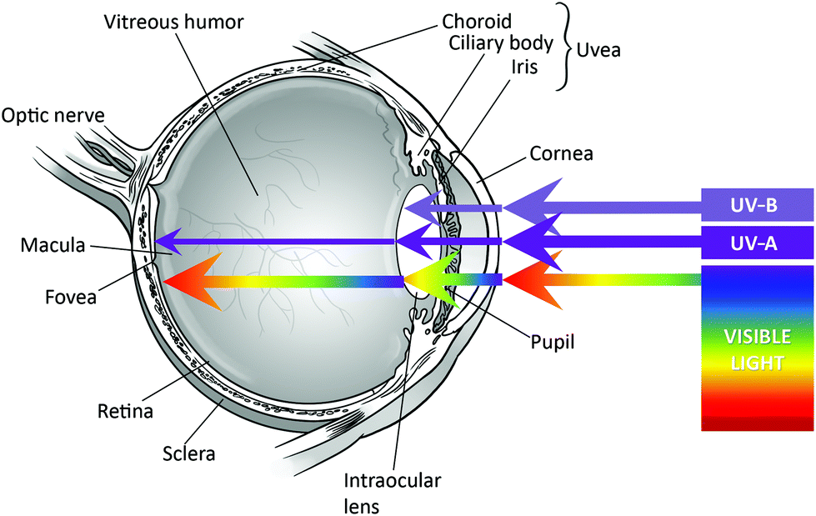
https://pubs.rsc.org/en/content/articlelanding/2019/pp/c8pp90060d#!divAbstract
Notes:
*Macular degeneration is a medical condition which usually affects older adults and results in a loss of vision in the centre of the visual field (the macula) because of damage to the retina.
** A cataract is a clouding of the lens inside the eye which leads to a decrease in vision.
*** Increased use of electronic devices like tablets, smart phones and pc laptops which give of a sharp ‘blue light’ has raised concern for retinal health.
ถัดไปทางขมับของจานประสาทตามีส่วนที่เรียกว่า จุดเห็นชัด (macula) ซึ่งตรงกลางมีจุดที่เรียกว่ารอยบุ๋มจอตา (fovea) เป็นหลุมที่ทำให้เราสามารถมองเห็นได้ชัดที่สุดตรงกลางลานสายตา แต่มีระดับความไวแสงน้อยกว่าส่วนอื่นเนื่องจากไม่มีเซลล์รูปแท่ง สัตว์อันดับวานรรวมทั้งมนุษย์มีรอยบุ๋มเดียวในตาแต่ละข้าง เทียบกับนกบางชนิดเช่นเหยี่ยวซึ่งมีรอยบุ๋ม 2 แอ่งในตาแต่ละข้าง (bifoviate) และสุนัขและแมวซึ่งไม่มีรอยบุ๋มจอตา แต่มีแถบกลางตาที่เรียกว่า visual streak
จุดรับภาพตรงกลางของจอประสาทตา ( macula ) และภาพทางขวาเป็นลักษณะของจุดรับภาพที่ปรกติ บริเวณนี้เป็นพื้นที่ที่มีความไวต่อแสงมาก ทำหน้าที่เกี่ยวกับการมองเห็นภาพตรงกลางของลานสายตา ให้รายละเอียด และความชัดเจนของภาพที่เรามองเห็นมากที่สุดเมื่อเปรียบเทียบกับบริเวณอื่นของจอประสาทตา

Slide 10
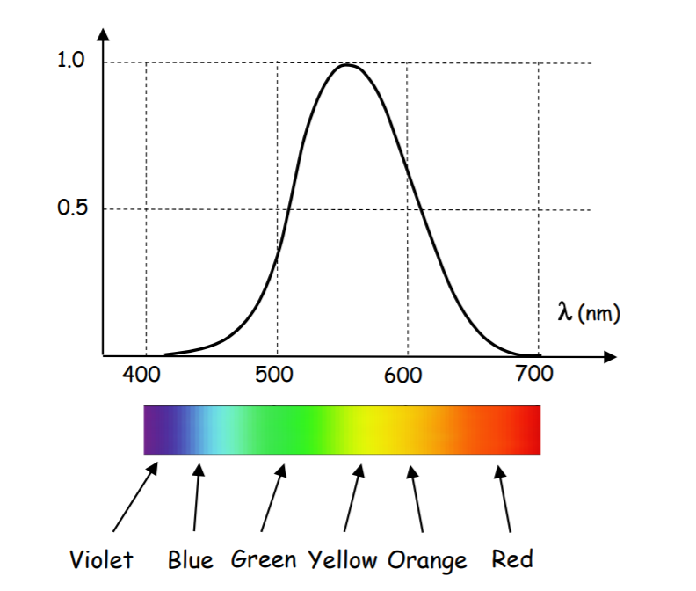
Spectral sensitivity of human eye
In visual neuroscience, spectral sensitivity is used to describe the different characteristics of the photopigments in the rod cells and cone cells in the retina of the eye.
It is known that the rod cells are more suited to scotopic vision and cone cells to photopic vision, and that they differ in their sensitivity to different wavelengths of light.
It has been established that the maximum spectral sensitivity of the human eye under daylight conditions is at a wavelength of 555 nm, while at night the peak shifts to 507 nm.
https://www.kth.se/social/files/542d2474f27654546973166c/Fotoslides4.pdf
Notes:
The vision of the eye under low light level = scotopic vision
The vision of the eye under well lit condition = photopic vision

Slide 11
InfraRed Light
The IR portion comprises wavelength between 750 nm to 1 mm.
The IR portion can be further subdivided into several zones such as near infrared (750 -1400 nm, mid infrared (3 μm to 6 μm) and far infrared (15 μm to 1000 μm)
Human perception is insensitive to IR.
Particular detecting devices are needed for the IR detection.

Slide 12
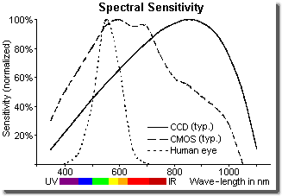
The spectral sensitivity of the human eye in bright light mode in comparison with that of CCD and CMOS sensors in the visible and near infrared spectrum. (Each curve is normalized on its maximum.)
http://www.fen-net.de/walter.preiss/e/slomoinf.html

Slide 13
Detection IR from a remote control with a smart phone
Generally, the IR emitted by a remote control has a wavelength of 940 nm which undoubtedly invisible to human eye.
Try out with your smart phone by observing the IR emitted by the remote control with both front and rear cameras.
Explain what you have found from this experiment!

Slide 14
Interaction of light and matter
“Reflection”
The reflection of light from a surface can provide a simple method to detect latent evidence.
The reflection of a surface depends on its reflectivity.
The wavelength of the reflected light is not shifted during the process.
The amplitude of the reflected light is less than the amplitude of the incident light.
Notes:
จุ่มหลอดทดลองในน้ำมัน

Slide 15
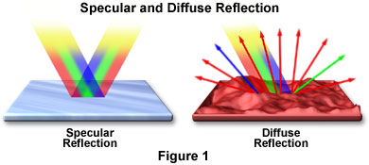
Reflection from surfaces
http://micro.magnet.fsu.edu/primer/java/reflection/specular/index.html

Slide 16
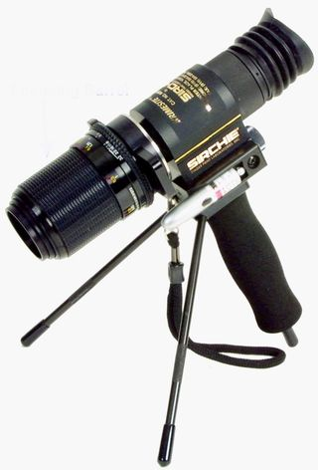
RUVIS
(Reflected Ultra-Violet Imaging System)
The instrument uses intensified UV reflectance from the smooth, non-porous surfaces where the evidence is found.
RUVIS devices use 254nm (UVC) UV light but they are not detecting fluorescence. Instead the device looks for the reflections and scatter of the 254nm light off of the fingerprint ridges comparing to the background.
Notes:
As the surface is exposed to the UV light, the materials left behind, for example oily residues or amino-acids in the case of a fingerprint, will scatter the UV light or absorb it. The viewer sees the scatter off the ridges and allows the technician to see the latent print on the surface. By changing the angle of the light, the contrast of the print changes and its visibility can be increased, the allowing the visualization and photography of the latent print without any treatment or contact

Slide 17
A strong contrast between the fingerprint ridges and background can be observed.
Two possible sources of the strong contrast include stronger background reflection (i.e. fingerprint residues also absorb UV) and more scattering due to the roughness of the fingerprint residues.
https://www.gov.uk/.../uploads/.../fsb-chap4-imaging.pdf
Notes:
Note super glue help to enhance the scattering of the uv light by introducing needle like molecule to the fingerprint residues
The scattering is pronounced when the size of scatterers are comparable to the wavelength of the incident light.

Slide 18
UV reflection on porous surface
The contrast is due to different amounts of light from the fingerprint residues (UV absorption) and background (fluorescence by UV) .
https://www.gov.uk/.../uploads/.../fsb-chap4-imaging.pdf

Slide 19
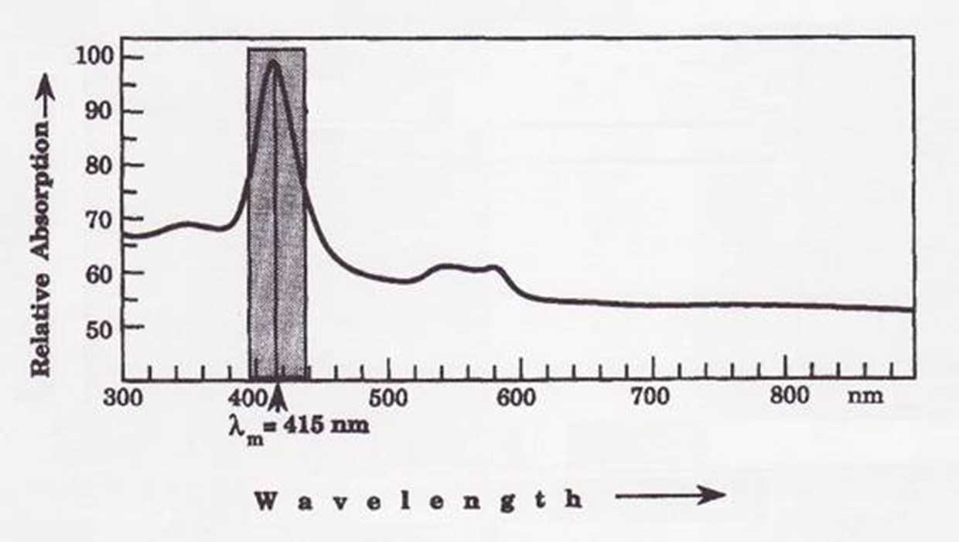
Absorption
The UV-visible spectrum of blood shows a prominent absorption peak at 415 nm due to hemoglobin.
If a blood spattered surface is observed with monochromatic light with this wavelength, the blood spots will appear as dark regions, because they will absorb all the radiation impinging upon them.
If the surface does not absorb at 415 nm, or even if it reflects a portion of it, the substrate will lighten up, improving the contrast of the image.
Although blood has a high absorption in a very broad region (300 – 900 nm) it has a strong and narrow absorption band with a maximum centered around 415 nm.
http://www.wavesignal.com/Forensics/Blood.html
Notes:
In the absorption spectrum depicted above, note that the absorption is the weakest above 600 nm. This results in the reflection of visible light and the appearance of red wavelengths of the visible spectrum
Hemoglobin: The oxygen-carrying pigment and predominant protein in the red blood cells. Hemoglobin forms an unstable, reversible bond with oxygen. In its oxygenated state it is called oxyhemoglobin and is bright red. In the reduced state it is called deoxyhemoglobin and is purple-blue.

Slide 20
If you are asked to take a clear picture of the bloody fingerprint on a book cover, how you can do to enhance the bloody fingerprints?
Notes:
The surface is illuminated with 415 nm light. All parts except the bloody area reflect the incident light. Therefore, the bloody fingerprint appears darker than the background does.

Slide 21
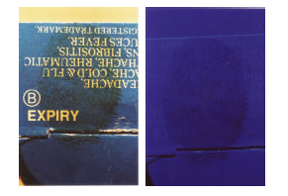
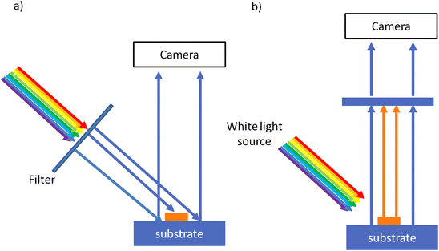
Solution
(b) Under the white light illumination, the surface can directly be observed by a filter that allows only 415 nm light to pass. The bloody area appears darker than the rest of the surface.
(a) The surface can be illuminated with 415 nm light. All parts except the bloody area reflect the incident light. Therefore, the bloody fingerprint appears darker than the background does.
Filter
https://pubs.rsc.org/en/content/chapterhtml/2018/bk9781782627685-00001?isbn=978-1-78262-768-5&sercode=bk
Notes:
The former method (a) is more efficient, but must be performed in the dark. The latter (b) has the advantage that can be applied in sunlight or in conditions of artificial lighting.

Slide 22
Interaction of light and matter
“Photoluminescence”
The interaction between the illuminating light and certain material results in a visible effect known as photoluminescence.
The emission of light involves the transition of atoms or molecules of a material from an excited state to ground state. The excess energy is released in the form of light. The radiation can cover UV, visible and IR ranges.
Notes:
Basically luminescence การเรืองแสง of cold light is the process by which light is emitted without a simultaneous change in temperature.
If the excitation is made by light, this process is called photoluminescence.

Slide 23
Energy states in a molecule
Energy states of a molecule are composed of electronic, vibration and rotation.
The electrons in atoms and molecules can move between different energy states by either absorbing energy (moving to a higher energy state) or emitting energy (moving to the lower energy state).

Slide 24
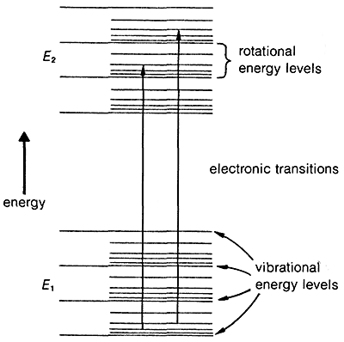
A more complicated of molecular energy diagram
Schematic representation of electronic, vibrational, and rotational energy levels.
The transitions between electronic states can produce radiation in UV and visible range.
The transitions between vibrational states can produce radiation in the infrared range.
The transition between rotational states can produce radiation in the far infrared and microwave.
Notes:
The transitions between electronic states can produce radiation in UV and visible range.
The transitions between vibrational stats can produce radiation in the infrared range.

Slide 25
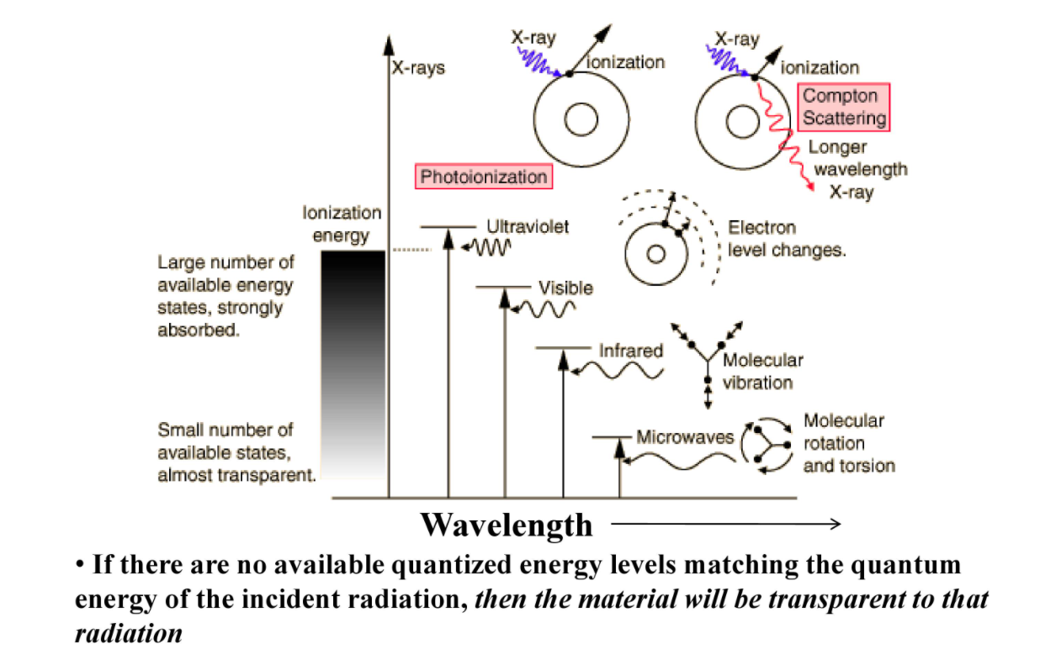
Radiation from molecules
Radiation from electronic transition
Radiation from vibrational transition
Radiation from rotational transition
https://www.learnpick.in/prime/documents/notes/details/4233/rotational-spectroscopy%22

Slide 26
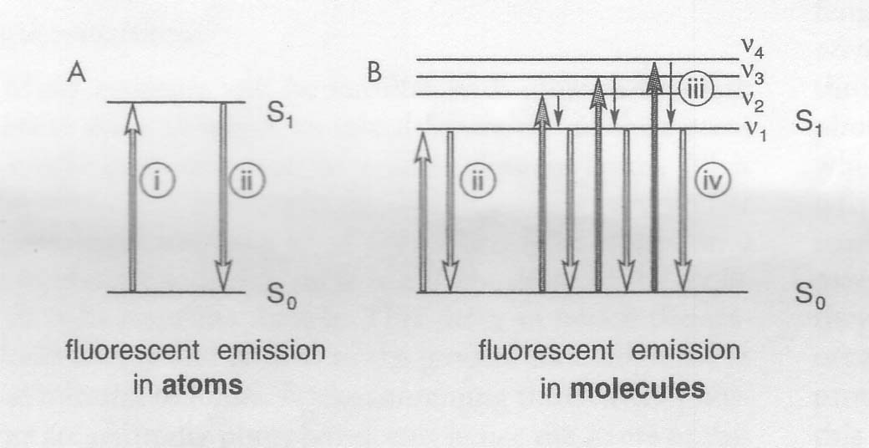
Fluorescence diagrams
(simplified version)
Re-radiation with longer wavelengths
Energy levels in atoms
Energy levels in molecules
ν_{i} = vibrational level i
Notes:
Up arrow I indicates excitation light. Down arrow represents emission of light from atoms that occurs when an electron moves from state S1 to So and is called direct or resonant fluorescence ii.
Up arrow indicate excitation with photons of increasingly short wavelengths (higher energy). Emission of light in molecules can occur as simple resonant fluorescence ii or alternatively some of the excited energy can be lost through internal conversion iii between vibronic level v1, v2, v3 , v4 in S1 and then emitted as fluorescent light which is red-shifted iv

Slide 27
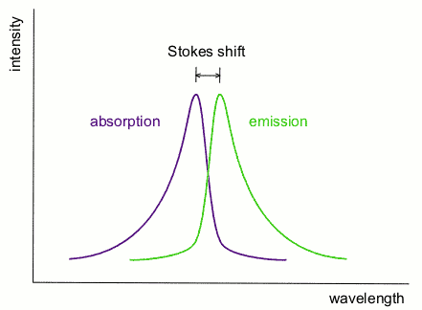
Stokes shift
The difference (in wavelength or frequency units) between positions of the band maxima of the absorption and the emission spectra.
Notes:
The existence of a Stokes shift means that emitted light can be detected against a low background. Independently of the excitation wavelength.
More details on stokes shift
https://www.edinst.com/blog/what-is-the-stokes-shift/

Slide 28
Fluorescence
Fluorescent emission in atoms : energy of emitted photon is exactly the same as the energy of absorbed photon. This process is called resonant fluorescent emission.
Fluorescent emission in molecules : energy of emitted photon is less than the energy of absorbed photon due to non-radiant loss . This process is call redshifted fluorescent emission; i.e. the re-radiation having a longer wavelength.
Notes:
When atoms are excited to higher electronic energy states, they return to the ground state by emission of a photon exactly the same energy as that used to excite them. This type of fluorescence is called resonant fluorescent emission.
For the fluorescent emission in molecules or redshifted fluorescent emission, the photon that is emitted from the system has a wavelength that is longer than the wavelength of excitation (lower in energy).

Slide 29
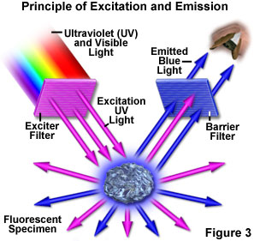
Set-up for detecting fluorescence
http://www.olympusmicro.com/primer/lightandcolor/fluorointroduction.html

Slide 30
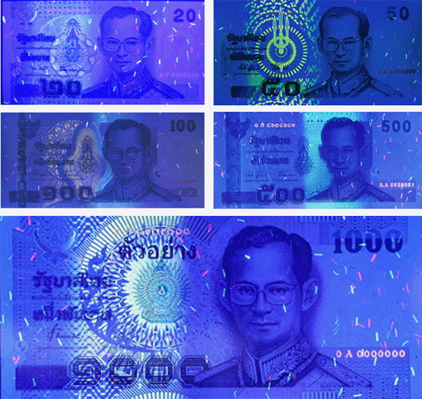
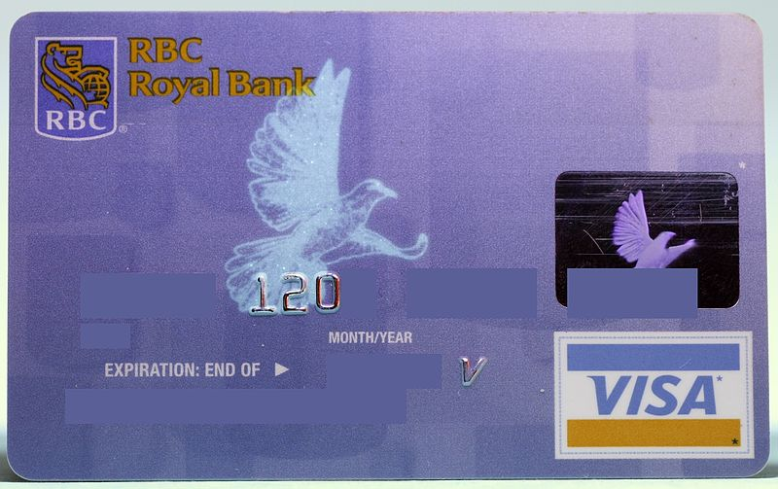
Fluorescence of common objects
Note : The fluorescence stops once the excitation light is removed.
http://www.bot.or.th
Notes:
หมึกพิมพ์พิเศษเรืองแสง การเรืองแสงของลวดลายสีพื้น หมวดอักษรและเลขหมาย

Slide 31
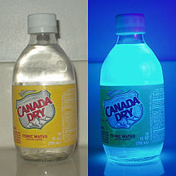
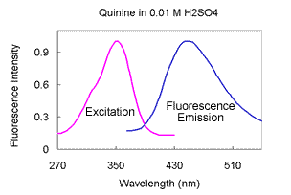
Fluorescence of tonic water
Tonic water, in normal light and ultraviolet "black light". The quinine content of tonic water causes it to fluoresce under black light.
https://en.wikipedia.org/wiki/Quinine
https://www.kutztown.edu/
Notes:
Regardless of which
excitation wavelength is used, the wavelength of maximum
fluorescence is 450 nm. With a scanning fluorimeter, we
have used a 350 nm excitation wavelength and 450 nm
emission wavelength throughout.

Slide 32
Notes:
Screening of urine
for auinine is a fairly common method for effective surveil-
~ancko f heroin abuse within a narcotic control, treatment,
or aftercare program, since quinine is a common diluent of
illegal heroin samples.
Quinine is a bitter tasting powder extracted from the bark of the cinchona tree of South America. Quinine, used in medicine, became popular as an antimalaria drug, and in the 1940’s drug pushers, concerned about their decreasing clientele from the epidemic of malaria sweeping the streets, added quinine to heroin. As a result of this new practice, the malaria outbreak in New York was reasonably controlled. The use of quinine in illicit preparations continues today, because quinine’s bitter taste prevents heroin buyers from being able to judge the quality of heroin sold as well as adds to the “rush” of the heroin injection.
Heroin and Cocaine Adulteration David C. Perry & Bruce E. Ratcliffe To cite this article: David C. Perry & Bruce E. Ratcliffe (1975) Heroin and Cocaine Adulteration, Clinical Toxicology, 8:2, 239-243, DOI: 10.3109/15563657508988068 To link to this article: https://doi.org/10.3109/15563657508988068

Slide 33
Cutting agent
Quinine is sometimes detected as a cutting agent in street drugs such as cocaine and heroin.
Screening of urine for quinine is a fairly common method for effective surveillance of heroin abuse within a narcotic control, treatment, or aftercare program, since quinine is a common diluent or “cut agent” of illegal heroin samples.
For more information on the cutting agents of illicit drugs

Slide 34
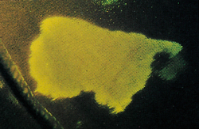
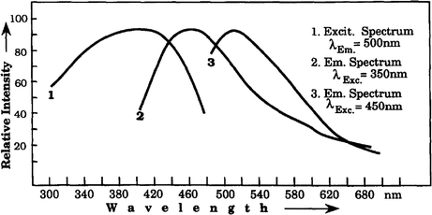
Latent evidence : semen
Detecting the presence of semen on cloth by using near-ultraviolet light. The excitation light is 450 nm and the fluorescence is observed through a yellow/orange filter.
Fluorescence spectra of semen with different excitation wavelengths. Reprinted from Forensic Science International, 51, M. Stoilovic, Detection of Semen and Blood Stains Using Polilight as a Light Source, Pages 289–296, Copyright (1991)
Notes:
Figure 1.6 shows, for example, that if semen is excited with light at 450 nm, it will emit fluorescent radiation with a maximum at about 520 nm. Practically, this operation is carried out using a tunable-wavelength light source set at 450 nm, and observing through a yellow/orange filter (e.g. 590 nm).¹⁹ If the surface is not very reflective at this wavelength, the semen stains should appear as bright yellow/orange spots on a dark background. If the substrate were luminescent in these illumination conditions, the contrast between the stain and the background would not be ideal. In such cases, other wavelengths should be tried, because semen, as many other biological fluids, is fluorescent in a wide range of conditions. It should be born in mind that as the wavelength of illuminating radiation is increased, the emission maximum is subsequently increased. Therefore, if for semen an illumination wavelength of 500 or 550 nm is used, the observation filter must have a colour more shifted to the red, orange and red, respectively.

Slide 35
Detection of dried semen using ALS
http://www.bvda.com/images/content/downloads/Locating_Semen_on_Live_Skin_Using_Visible_Fluorescence.pdf

Slide 36
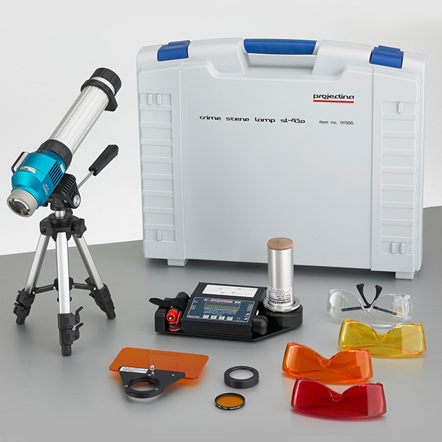
Forensic Light source
(Alternative Light Source)
The ALS is a portable, high-intensity, filtered light source.
The ALS is used by forensic scientists and others to detect fingerprints, body fluids and other evidence from crime scenes.
https://www.ultra-forensictechnology.com/en/our-products/crime-scene-equipment/crime-scene-lamp-sl-450

Slide 37
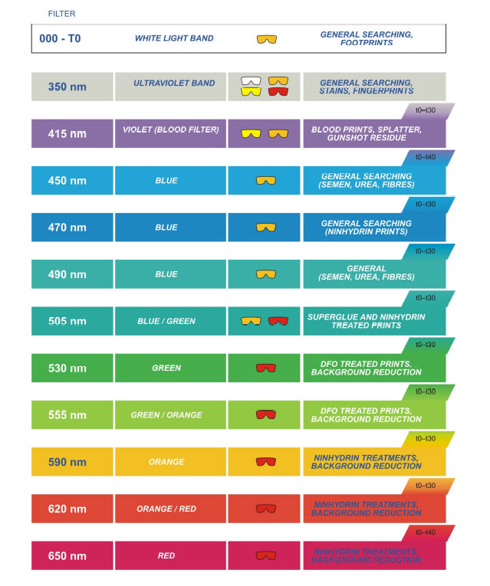
Exciting radiation
Screening filters
Notes:
Polilight filters and applications
One use for alternate light sources is the examination of a weapon such as a gun or knife. Finger and palm prints are nearly invisible on such metal surfaces when examined under room light. But, when viewed under a green light and observed through an orange filter, the prints can easily be seen. Similar lighting conditions and special film can be used to photograph prints.

Slide 38
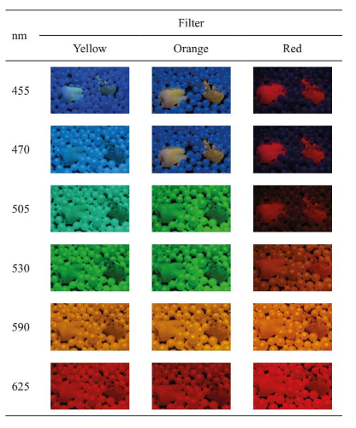
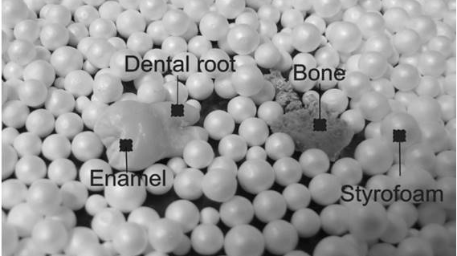
Use of an Alternate Light Source to Detect Tooth and Bone
Braz. Dent. J. vol.28 no.1 Ribeirão Preto Jan./Feb. 2017
http://dx.doi.org/10.1590/0103-6440201700892
Natural light exposure
Photographs of biological (tooth and bone samples) and inert (styrofoam balls) materials under different combinations of illumination wavelength (nm) and filter
http://www.scielo.br/scielo.php?script=sci_arttext&pid=S0103-64402017000100078

Slide 39
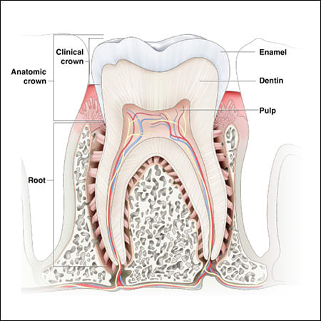
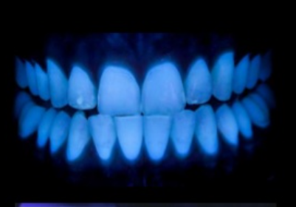
Fluorescence from teeth
https://www.dentalcare.com/en-us/professional-education/ce-courses/ce500/divisions-and-components-of-the-teeth
Human teeth are naturally fluorescent objects (also known as autofluorescent) because UV light is easily absorbed by the luminescent species present in dental tissues.
When UV light (between 350 and 400 nm) hits these tissues, it is initially absorbed and then emitted in the visible spectrum at longer wavelengths (between 410 and 500 nm).
Both enamel and dentin are fluorescent tissues, but enamel produces only a quite weak fluorescence because it contains a small amount of organic material.
Generally, teeth display a bluish-white color under UV light.
The fluorescence spectrum of natural enamel exhibits maximum luminescence peaks at 450 nm while the dentin shows peaks at 440 nmใ
https://onlinelibrary.wiley.com/doi/epdf/10.1111/jerd.12421
https://www.slideshare.net/keeratkuckreja1/color-of-natural-teeth

Slide 40
Conclusions
Radiation range that can be used in the forensic applications cover UV, Visible and Infrared.
Lightwave offers a simple but effective means for investigating latent trace evidence.
The process is non-destructive allowing further testing to be performed if required.

Slide 41
References
W C Lee and B E Khoo, “Forensic Light Source for Detection of Biological Evidences in Crime Scene Investigation : A Review”, Malaysian Journal of Forensic Science, 2010, Vol 1, p 17-27.
P B Ohara, Carol Engelson and W S Peter, “Turning on the Light: Lesson form Luminescence”, Journal of Chemical Education, Vol. 82, No. 1, 2005, p 49-52.
Light for crime scene examination : DOI: 10.1039/9781788010344-00001

Slide 42
การเก็บหลักฐานประเภท shoe print
สถานะการณ์ : พบรอยเท้าผู้ต้องสงสัยในที่เกิดเหตุ
สิ่งที่ต้องดำเนินการ :
1.เก็บรอย shoe print ด้วยการหล่อรอย shoe print ด้วยปูนพลาสเตอร์
2. นำรอยพิมพ์ปูนพลาสเตอร์ที่ได้ไปสืบค้นหาชนิดของรองเท้าและผู้ต้องสงสัย
3. เพื่อเป็นการยืนยันตัวผู้ต้องสงสัยให้ประมาณความสูงของผู้ต้องสงสัยจากระยะห่างระหว่างก้าวที่
พบในที่เกิดเหตุ
วิธีการประมาณความสูง
1. หาระยะก้าวต่อความสูงของสมาชิกแต่ละคนในกลุ่ม และนำมาคำนวณหาอัตราส่วนเฉลี่ย
2. นำอัตราส่วนดังกล่าวไปประมาณความสูงของผู้ต้องสงสัย
สรุปและอภิปรายผล

